Slide 1
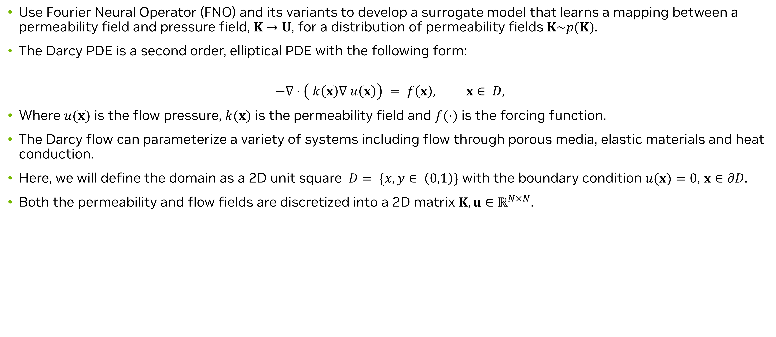
Data-driven analysis – Surrogate Model for Darcy Flow
Problem description
Use Fourier Neural Operator (FNO) and its variants to develop a surrogate model that learns a mapping between a permeability field and pressure field, $K→U$, for a distribution of permeability fields $K\sim p(K)$.
The Darcy PDE is a second order, elliptical PDE with the following form:
$$−∇⋅\left( k\left(x\right)∇ u\left(x\right)\right) = f\left(x\right), x∈ D,$$
Where $u(x)$ is the flow pressure, $k(x)$ is the permeability field and $f(⋅)$ is the forcing function.
The Darcy flow can parameterize a variety of systems including flow through porous media, elastic materials and heat conduction.
Here, we will define the domain as a 2D unit square $D= \{x, y∈ \left(0,1\right)\}$ with the boundary condition $u(x)=0$, $x∈∂D$.
Both the permeability and flow fields are discretized into a 2D matrix $K, u∈ℝ^{N×N}$.
Notes:
That completed our Physics-informed training aspects using Modulus. Next, will start looking into the data-driven training.
For all the data-driven setups we will consider henceforth, we will consider a darcy flow problem. The goal is to develop a surrogate model that learns the mapping between a permeability field and the pressure field, i.e. a map between K and U (K→U), for a distribution of permeability fields K∼p(K). In this problem, we are not learning just a single solution but rather a distribution.
The Darcy PDE is a second order, elliptic PDE with the form shown here. Here, u(x) is the flow pressure, k(x) is the permeability field and f(⋅) is the forcing function. The Darcy flow can parameterize a variety of systems including flow through porous media, elastic materials and heat conduction. Here, we will define the domain as a 2D unit square D={x,y∈(0,1)} with the boundary condition u(x)=0,x∈∂D. Both the permeability and flow fields are discretized into a 2D matrix K,U∈RN×N.

Slide 2
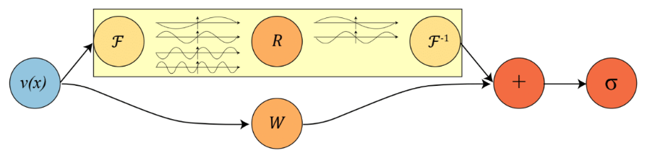
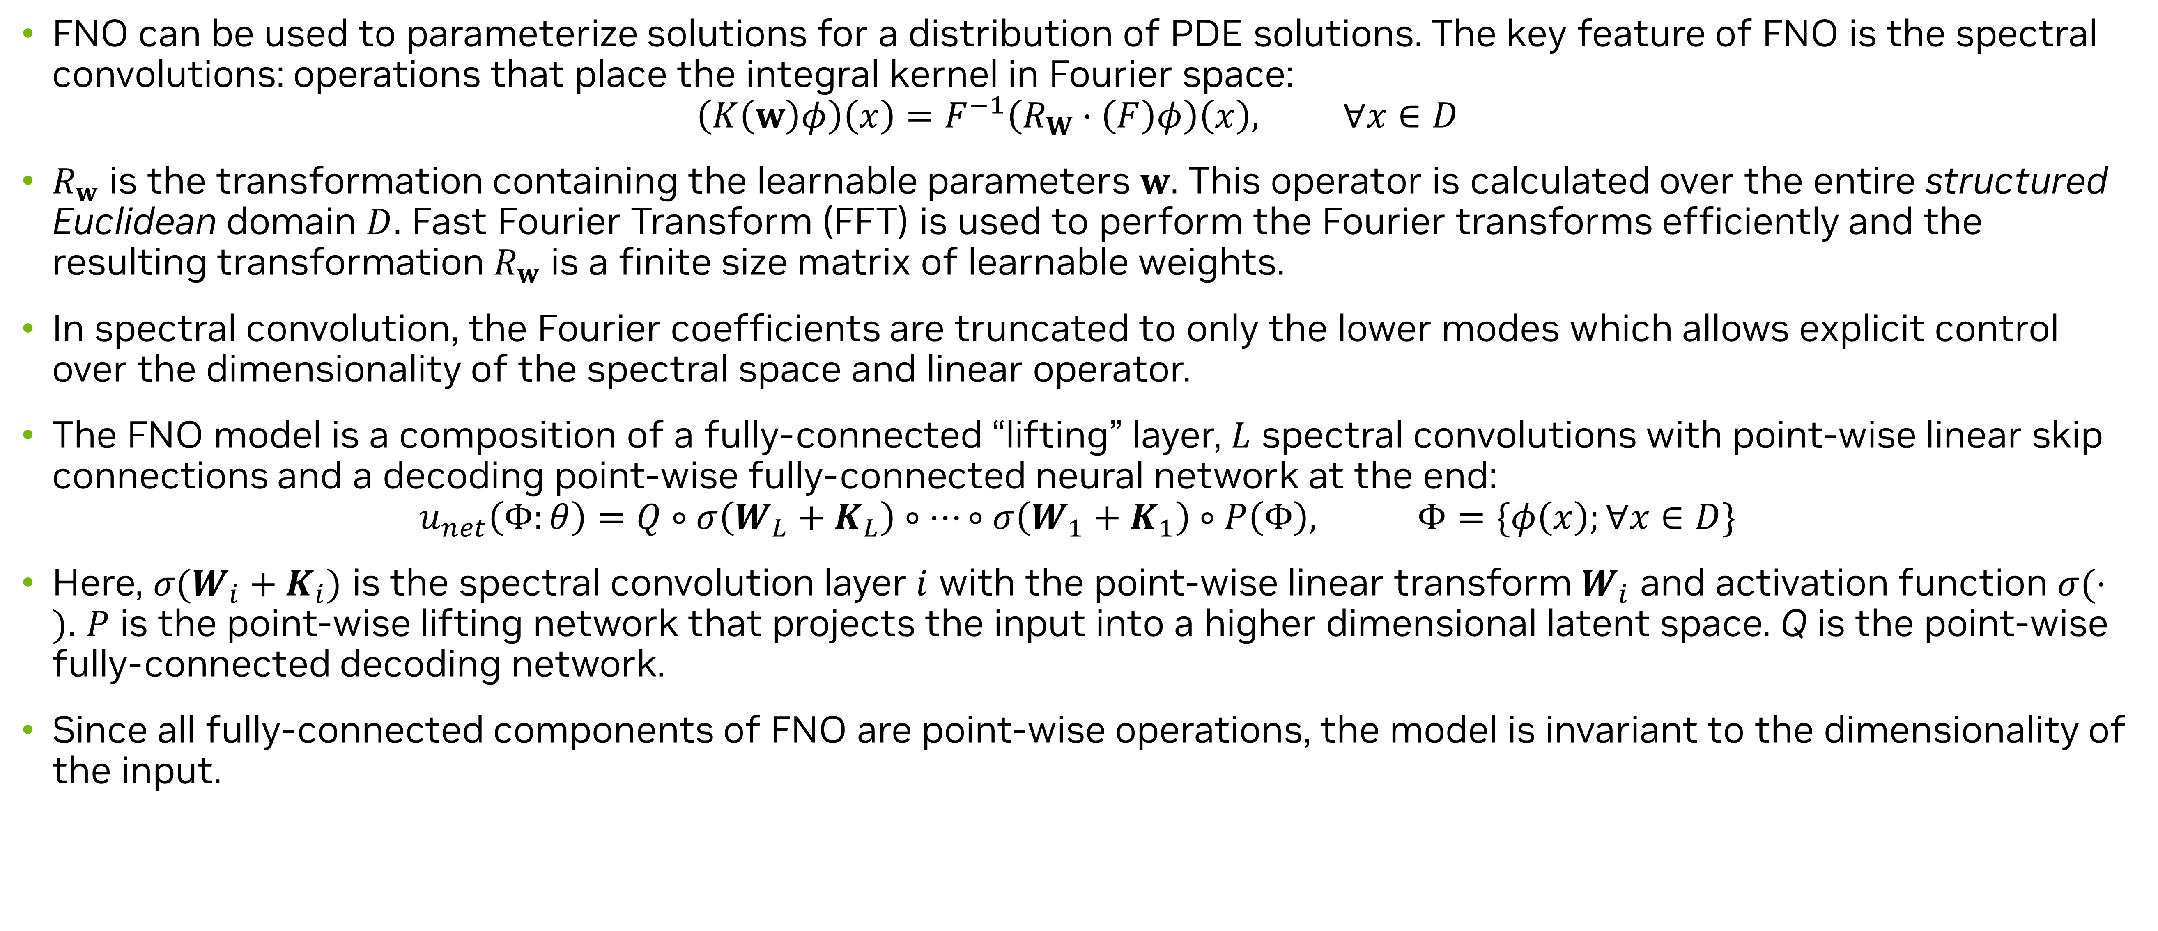
Darcy Flow – Fourier Neural Operators (FNO)
Theory
FNO can be used to parameterize solutions for a distribution of PDE solutions. The key feature of FNO is the spectral convolutions: operations that place the integral kernel in Fourier space:​
$$\left(K\left(w\right)φ\right)\left(x\right)=F^{−1}\left(R_{W}⋅\left(F\right)φ\right)\left(x\right), ∀x∈D$$
$R_{w}$ is the transformation containing the learnable parameters $w$. This operator is calculated over the entire structured Euclidean domain $D$. Fast Fourier Transform (FFT) is used to perform the Fourier transforms efficiently and the resulting transformation $R_{w}$ is a finite size matrix of learnable weights. ​
In spectral convolution, the Fourier coefficients are truncated to only the lower modes which allows explicit control over the dimensionality of the spectral space and linear operator.​
The FNO model is a composition of a fully-connected “lifting” layer, $L$ spectral convolutions with point-wise linear skip connections and a decoding point-wise fully-connected neural network at the end:​
$$u_{net}\left(Φ:θ\right)=Q∘σ\left(W_{L}+K_{L}\right)∘…∘σ\left(W_{1}+K_{1}\right)∘P\left(Φ\right), Φ=\{φ\left(x\right);∀x∈D\}$$
Here, $σ(W_{i}+K_{i})$ is the spectral convolution layer $i$ with the point-wise linear transform $W_{i}$ and activation function $σ(⋅)$. $P$ is the point-wise lifting network that projects the input into a higher dimensional latent space. Q is the point-wise fully-connected decoding network. ​
Since all fully-connected components of FNO are point-wise operations, the model is invariant to the dimensionality of the input. ​
Source: Li et al., 2010.08895.pdf (arxiv.org)
Notes:
A little bit of theory on the Fourier Neural Operators. The key feature of Fourier Neural Operators, or FNOs is the spectral convolutions. Operations that take place in the integral kernel in Fourier space. The Fourier layer consists of three steps:
Take the fourier transform of the input
Do a Linear transform on the lower Fourier modes R
Take the inverse Fourier transform
The output of the fourier layer is then added with the bias term W which is a linear transformation. Finally, an activation activation function \sigma is applied. Simple as it is.
In practice, it’s usually sufficient to only take the lower frequency modes and truncate out these higher frequency modes. Therefore, the linear transformation is applied on the lower frequency modes and set the higher modes to zeros. That should give you a good high-level understanding of the fourier layer. The FNO model is a composition of a fully connected “lifting layer”, L spectral convolutions with point-wise linear skip connections and a decoding point-wise fully-connected neural network at the end. Since all the fully-connected components of FNO are point-wise operations, the model is invariant to the dimensionality of the input.
For more details, please refer the paper by Li and colleagues.

Slide 3
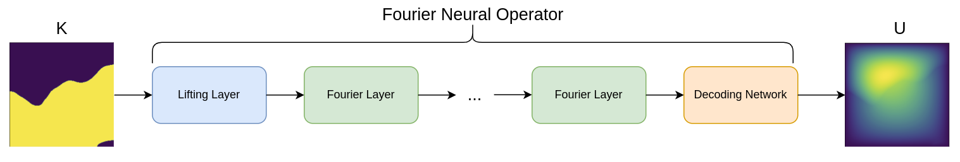
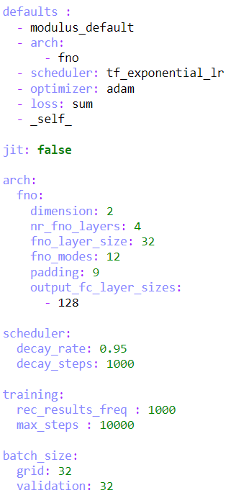
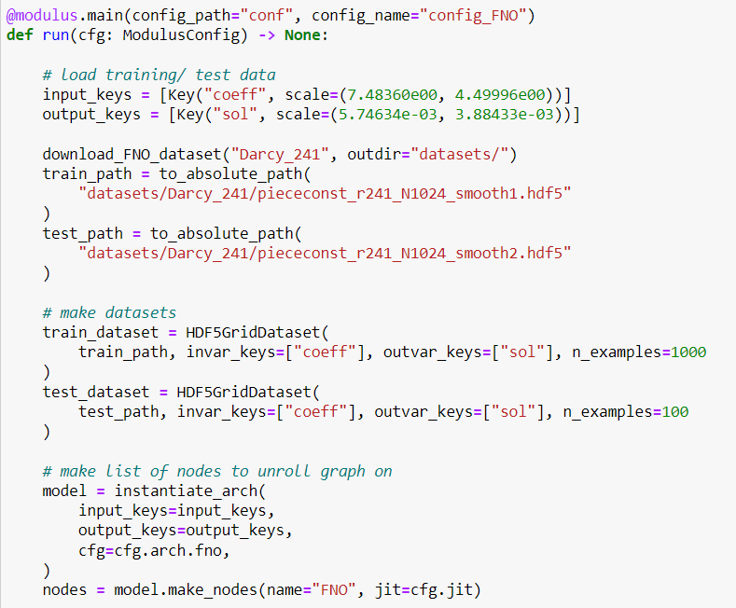
Darcy Flow – Fourier Neural Operators (FNO)
Code Snippets
Lazy data loading (in addition to eager loading) available for large datasets
Instantiate the FNO model. Network parameters handled in configs.
Hydra configs for the Darcy FNO problem
Notes:
Now let’s look at how to use FNOs in Modulus. For this data-driven problem, the first step is to get the training data into Modulus. Prior to loading data, we can set any normalization value that we want to apply to the data. For this dataset, we calculated the scale and shift parameters for both the input permeability field and output pressure. Then, we set this normalization inside Modulus by providing the scale/shift to each key, Key(name, scale=(shift, scale)). There are two approaches for loading data: First, use eager loading where you immediately read the entire datast into memory at one time. Alternatively, you can use lazy loading where the data is loaded on a per example basis as the model needs it for training. The eager loading eliminates potential overhead from reading data from disc during training, however this cannot scale to large datasets. Lazy loading is used in this example for both the training and test datasets to demonstrate this utility for larger problems.
Initializing the model and domain follows the same steps as the other PINN models we saw earlier.
Using Hydra to manage the configs of the models makes hyper parameter tuning very easy. This is an essential part for the data-driven machine learning.

Slide 4
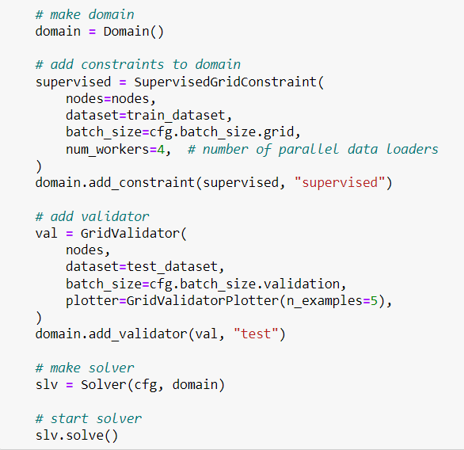
Darcy Flow – Fourier Neural Operators (FNO)
Code Snippets
Note
The constraint will construct the data loader automatically.
Modulus constraints can instantly be scaled to multi-node/multi-GPU training.
Optimizations such as torch script/CUDA graphs will be performed under-the-hood.
Batch size is controlled in the Hydra configuration file.
These are the two core components of setting up basic data-driven problem in Modulus.
Supervised grid constraints
Grid Validators
Notes:
For the physics-informed problems in Modulus, we typically need to define a geometry and constraints based on boundary conditions and governing equations. Here, the only constraint is a SupervisedGridConstraint which performs standard supervised training on grid data. This constraint supports the use of multiple workers, which are particularly important when using lazy loading. We can then add the validation data to the domain using GridValidator which should be used when dealing with structured data.
Note: Grid data refers to data that can be defined in a tensor like an image. Inside Modulus, this grid of data typically represents a spatial domain and should follow the standard dimensionality of [batch, channel, xdim, ydim, zdim] where channel is the dimensionality of your state variables. Both Fourier and convolutional models use grid-based data to efficiently learn and predict entire domains in one forward pass, which contrasts to the pointwise predictions of standard PINN approaches

Slide 5
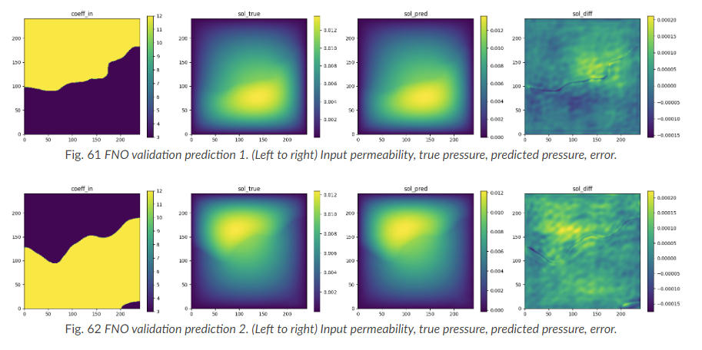
Darcy Flow – Fourier Neural Operators (FNO)
Results and discussion
FNO accurately learns the solution of this system.
Modulus supports the visualization of results through images (matplotlib), Tensorboard, VTK files and Omniverse for select problems.
For more information, please refer to the official Modulus user guide example.
Notes:
You can see that the model is able to accurately predict the pressure field for permeability fields it had not seen previously. These visualizations can also be viewed during the training using the Tensorboard.
Modulus supports visualization of results via images (matplotlib), Tensorboard, VTK files and Omniverse extension for select problems. For more details and information, please refer the official user guide.

Slide 6
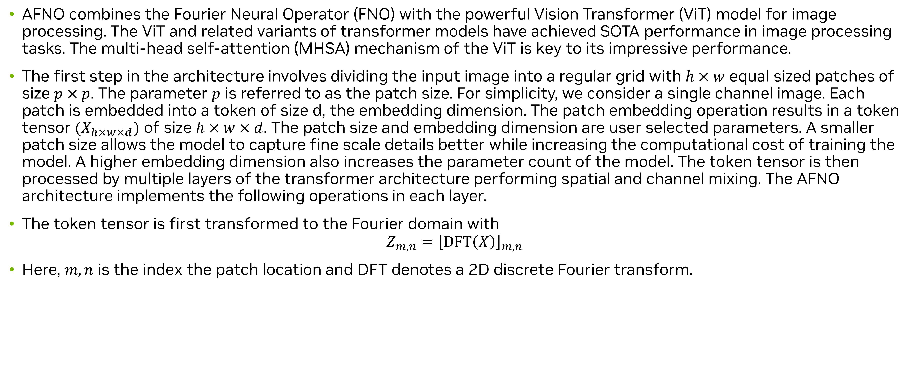
Darcy Flow – Adaptive Fourier Neural Operators (AFNO)
Theory
AFNO combines the Fourier Neural Operator (FNO) with the powerful Vision Transformer (ViT) model for image processing. The ViT and related variants of transformer models have achieved SOTA performance in image processing tasks. The multi-head self-attention (MHSA) mechanism of the ViT is key to its impressive performance. ​
The first step in the architecture involves dividing the input image into a regular grid with $h×w$ equal sized patches of size $p×p$. The parameter $p$ is referred to as the patch size. For simplicity, we consider a single channel image. Each patch is embedded into a token of size d, the embedding dimension. The patch embedding operation results in a token tensor $(X_{h×w×d})$ of size $h×w×d$. The patch size and embedding dimension are user selected parameters. A smaller patch size allows the model to capture fine scale details better while increasing the computational cost of training the model. A higher embedding dimension also increases the parameter count of the model. The token tensor is then processed by multiple layers of the transformer architecture performing spatial and channel mixing. The AFNO architecture implements the following operations in each layer.​
The token tensor is first transformed to the Fourier domain with​
$$Z_{m,n}={\left[DFT\left(X\right)\right]}_{m,n}$$
Here, $m,n$ is the index the patch location and DFT denotes a 2D discrete Fourier transform. ​
Notes:
Now let’s look at another Data-driven model in Modulus. This one is called the Adaptive Fourier Neural Operators, or AFNO. In contrast with the Fourier Neural Operator which has a convolutional architecture, the AFNO leverages contemporary transformer architectures in the computer vision domain. Vision transformers have delivered tremendous success in computer vision. This is primarily due to effective self-attention mechanisms. To cope with this challenge, Guibas et al. proposed Adaptive Fourier Neural Operator (AFNO) as an efficient attention mechanism in the Fourier Domain. AFNO is based on principled foundation of operator learning which allows us to frame attention as a continuous global convolution efficiently in the Fourier domain. To handle challenges in vision such as discontinuities in images and high resolution inputs, AFNO proposes principled architectural modifications to FNO which results in memory and computational efficiency. This includes imposing a block-diagonal structure on the channel mixing weights, adaptively sharing weights across tokens, and sparsifying the frequency modes via soft-thresholding and shrinkage.
The AFNO model typically inculdes the following steps:
Dividing the input image into a regular grid with h×w equal sized patches of size p×p.
Embed the patch into a token of size d, the embedding dimension resulting in a token tensor ($X_{h\times w \times d}$) of size h×w×d.
Pass the token through multiple layers of transformer architecture performing spatial and channel mixing.
At the end of all the transformer layers, convert the feature tensor back to image space using a linear decoder.
The detailed description of the AFNO model is beyond the scope of this material and you are encouraged to look at the original paper for more details.

Slide 7
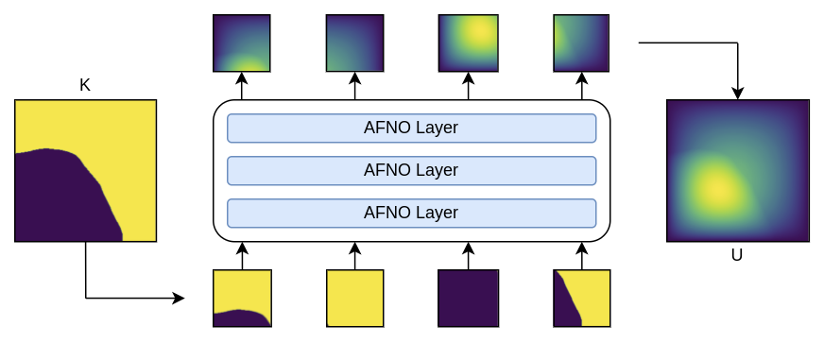
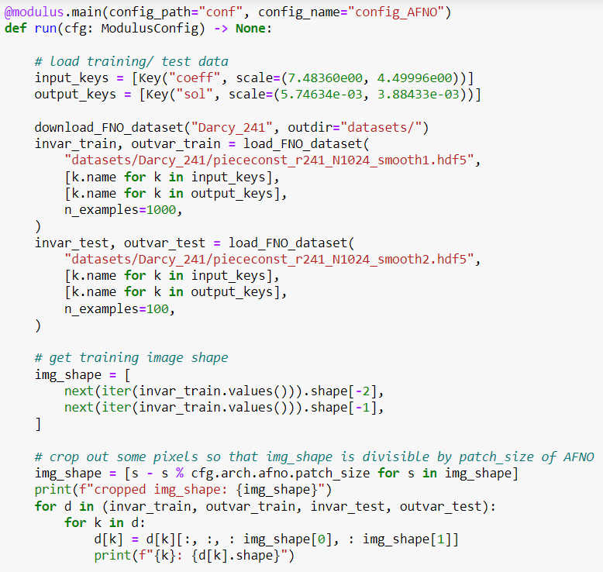
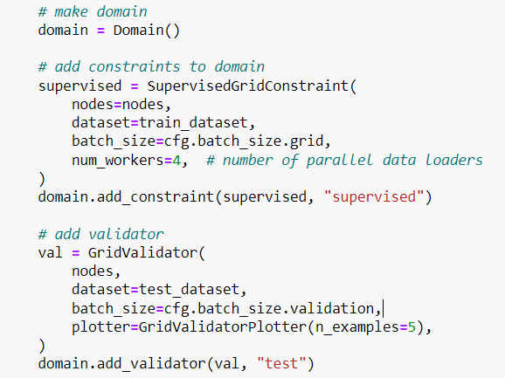
Darcy Flow – Adaptive Fourier Neural Operators (AFNO)
Code Snippets
Lazy loading like FNO example
Crop the data to make divisible by patch size
Constraints and Validators same as FNO example.
Without any changes to the core constraint/validator, experiment with different architectures with ease
Notes:
The process of setting the AFNO training is very similar from a case setup standpoint hence we will only highlight the important differences wherever necessary.
The AFNO is based on the ViT transformer architecture and requires tokenization of the inputs. Here each token is a patch of the image with a patch size defined in the configuration file through the parameter patch_size. The embed_dim parameter defines the size of the latent embedded features used inside the model for each patch.
Loading both the training and validation datasets into memory follows a similar process as seen in the FNO. The inputs for AFNO need to be perfectly divisible by the specified patch size (in this case, patch_size=16), which is not the case for this dataset. Therefore, we trim the input/output features such that they are have appropriate dimensionality 241x241 -> 240x240
Rest of the constraints and the validators etc. remains very similar to what we have seen earlier. Thus, Without any changes to the core constraint/validator, experiment with different architectures with ease.

Slide 8
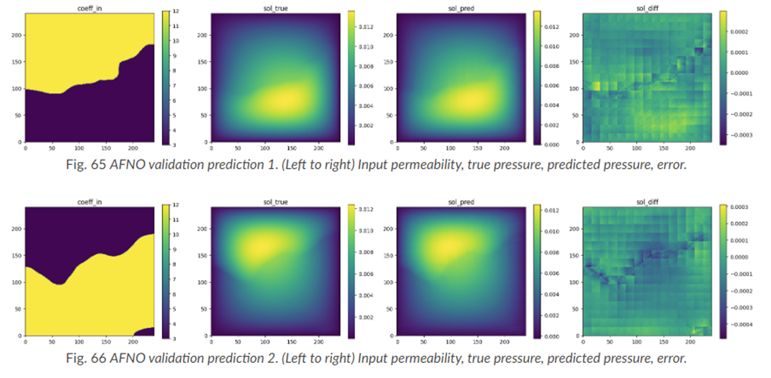
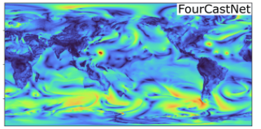
Darcy Flow – Adaptive Fourier Neural Operators (AFNO)
Results and discussion
AFNO accurately learns the solution of this system.
For more information, please refer to the official Modulus user guide example.
AFNO is the key backboard for NVIDIA’s groundbreaking FourCastNet:
Notes:
The results of the model after training are shown here. It is important to recognize that AFNO's strengths lie in its ability to scale to a much larger model size and datasets than what is used in this example. While not illustrated here, this example demonstrates the fundamental implementation of data-driven training using the AFNO architecture in Modulus for you to extend to larger problems. AFNO is key backboard for the NVIDIA’s groundbreaking FourCastNet.

Slide 9
Darcy Flow – Physics Informed Neural Operators (PINO)
Theory
PINO incorporates a PDE loss to the Fourier Neural Operator. This improves interpretability and reduces the amount of data required to train a surrogate model, since the PDE loss constrains the solution space. ​
In general, the PDE loss involves computing the PDE operator which in turn involves computing the partial derivatives of the Fourier Neural Operator ansatz, which is nontrivial. The key set of innovations in the PINO are the various ways to compute the partial derivatives of the operator ansatz. The PINO framework implements the differentiation in three different ways.​
Numerical differentiation using a finite difference Method (FDM).​
Numerical differentiation computed via spectral derivative.​
Hybrid differentiation based on a combination of first-order “exact” and second-order FDM derivatives.​
Notes:
Now let’s look at the final model that cominees data with physiscs. The PINO approach for surrogate modeling of PDE systems effectively combines the data-informed supervised learning framework of the FNO with the physics-informed learning framework. The PINO incorporates a PDE loss to the Fourier Neural Operator. This reduces the amount of data required to train a surrogate model, since the PDE loss constrains the solution space. The PDE loss also enforces physical constraints on the solution computed by a surrogate ML model, making it an attractive option as a verifiable, accurate and interpretable ML surrogate modeling tool.
To explain the key concepts behind PINO, consider a stationary PDE system. IN this example, we consider the same Darcy PDE.
In the FNO framework, the surrogate ML model is given by a the solution operator which maps any given coefficient in the coefficient space to the solution. The FNO is trained in a supervised fashion using training data in the form of input-output pairs. The training loss for the FNO is then given by summing the data loss, over all training pairs.
In the PINO framework, the solution operator is optimized with an additional PDE loss which is computed over independent and identically distributed samples from an appropriate supported distribution in parameter/coefficient space.
In general, the PDE loss involves computing the PDE operator which in turn involves computing the partial derivatives of the Fourier Neural Operator ansatz. In general, this is nontrivial. The key set of innovations in the PINO paper are the various ways to compute the partial derivatives of the operator ansatz, viz:
Numerical differentiation using a Finite-Difference Method (FDM).
Numerical differentiation computed via spectral derivative.
3. Hybrid differentiation based on a combination of first-order "exact" derivatives and second-order FDM derivatives.
For more details, please refer the Modulus User Documentation and the original paper by Li and colleagues.

Slide 10
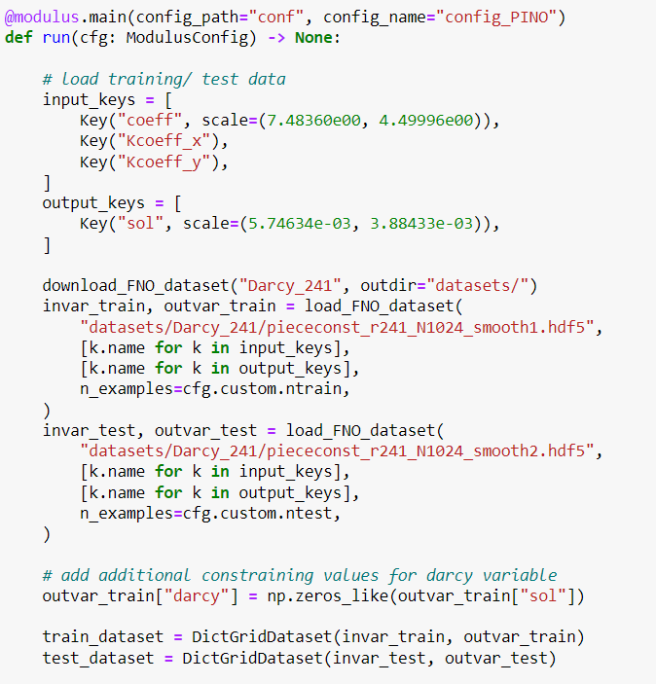
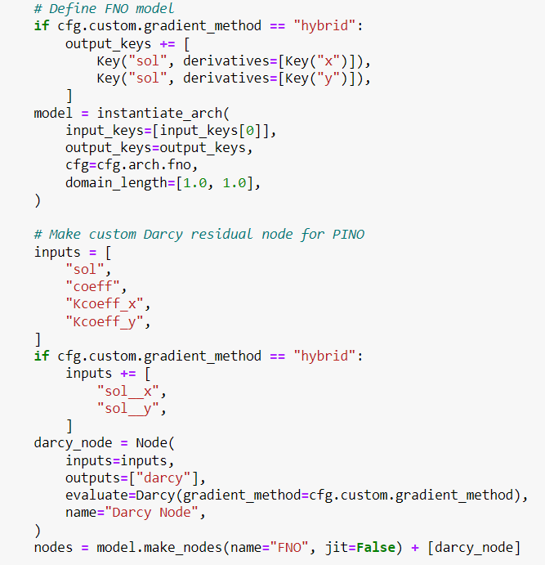
Darcy Flow – Physics Informed Neural Operators (PINO)
Code snippets
Setting up a PINO problem in Modulus requires setting up a custom PDE loss that can compute on grid data. Readers are referred to the supplemental Jupyter notebooks for the code snippets for the Loss definition.
Load additional gradients for the loss calculation
Additional nodes for physics loss
Loss for physics constraint
Notes:
The key difference between PINO and FNO is that PINO adds a physics-informed term to the loss function of FNO.
In Modulus, three different methods for computing the derivatives are provided. These are based on the original PINO paper:
Numerical differentiation computed via Finite-Difference Method (FDM)
Numerical differentiation computed via spectral derivative
Hybrid differentiation based on a combination of first-order "exact" derivatives and second-order FDM derivatives
The first 2 approaches are the same as proposed in the original paper. The third approach is a modification of the "exact" approach proposed in the paper. This method is slower and more memory intensive than the numerical derivative approaches when computing second order derivatives because it requires the computation of a Hessian matrix. Instead, a "hybrid" approach is provided which offers a compromise by combining first-order "exact“ derivatives and second-order FDM derivatives. Note: the exact method is not technically exact because it uses a combination of numerical spectral derivatives and exact differentiation, see original paper for more details.
Now considering the problem setup, it is largely the same as the FNO example, except that the PDE loss is defined and the FNO model is constrained using it. The definition of the PDE loss can be found in the supplemental Jupyter notebooks. Here we see that we specify some additional keys for gradient and loss calculation and some additional nodes are specified for the physics loss.

Slide 11
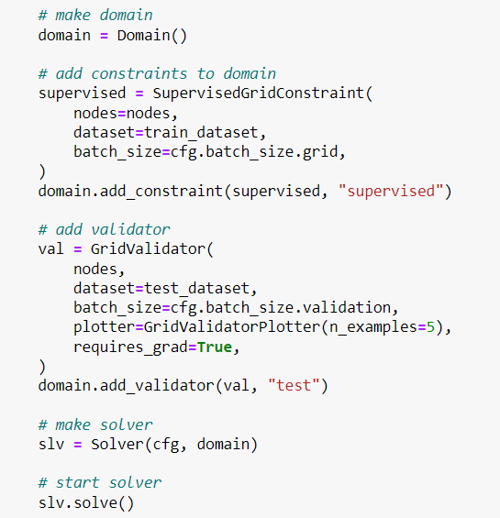
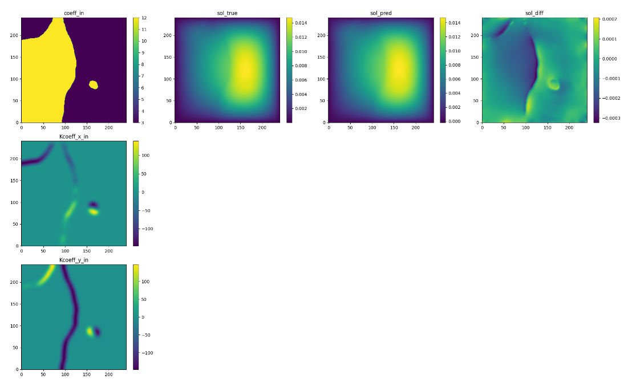
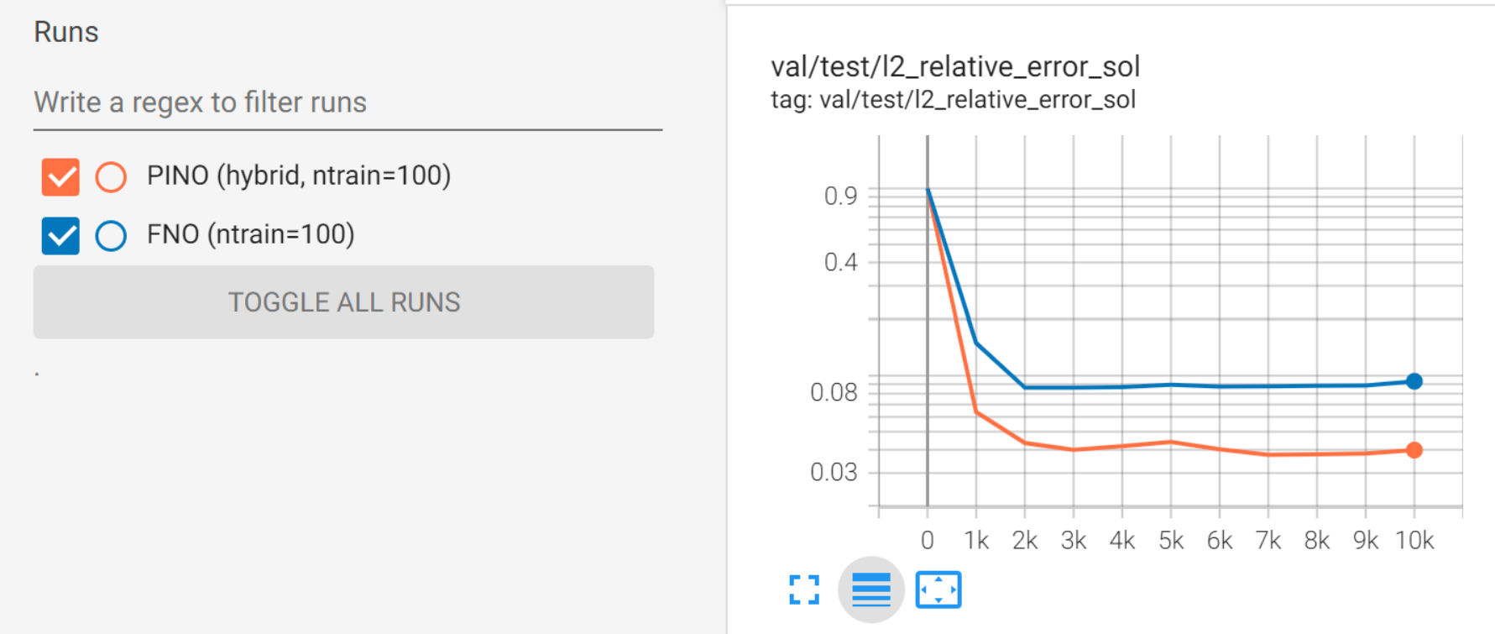
Darcy Flow – Physics Informed Neural Operators (PINO)
Code snippets and results and discussion
Results. Left: Inputs to the model (Input permeability and its gradients), Right: Model prediction and its comparison with true solution
Constraints and Validators same as FNO example.
Without any changes to the core constraint/validator, experiment with different architectures with ease
Benefit of PINO is seen in “small data” regimes where the PDE loss regularizes the model giving better prediction than FNO when trained with only 100 samples.
Notes:
Constraints and Validators same as FNO example. As seen before, without any changes to the core constraint/validator, we can experiment with different architectures with ease. The results of the model prediction are also shown here.
The Tensorboard plot below compares the validation loss of PINO (all three gradient methods) and FNO. You can see that with large amounts of training data (1000 training examples), both FNO and PINO perform similarly. A benefit of PINO is that the PDE loss regularizes the model, meaning that it can be more efficient in "small data" regimes. The plot below shows the validation loss when both models are trained with only 100 training examples. In this case, we find that PINO outperforms FNO.

Slide 12
Neural Operators in Modulus
Conclusions
Modulus supports several neural operators (also includes the famous DeepONets) that can easily be used out of the box.
Modulus uses Hydra configuration for easily adjusting hyperparameters and even changing model architectures with minimal changes to Python code.
Data-driven training can quickly be integrated into the Modulus framework.
For more information on supported models and examples please see the Modulus documentation.
Notes:
That completes our discussion on the FNO and its variants in Modulus. To summarize, Modulus supports several neural operators which also includes the famous DeepONets that can easily be used out of the box.
Modulus uses Hydra configuration for easily adjusting hyper-parameters and even changing model architectures with minimal changes to python code.
And Data-driven training can be quickly integrate into Modulus Framework. For more information on supported models and examples, please refer to the Modulus user documentation.

Slide 13
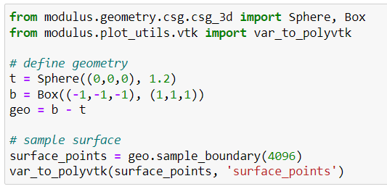
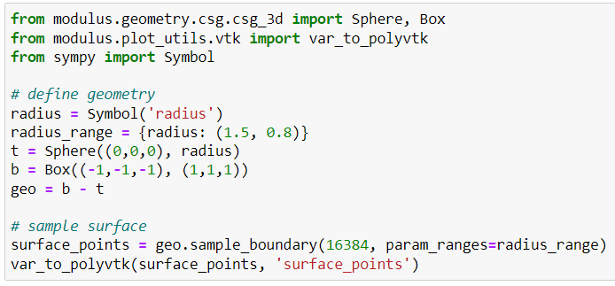
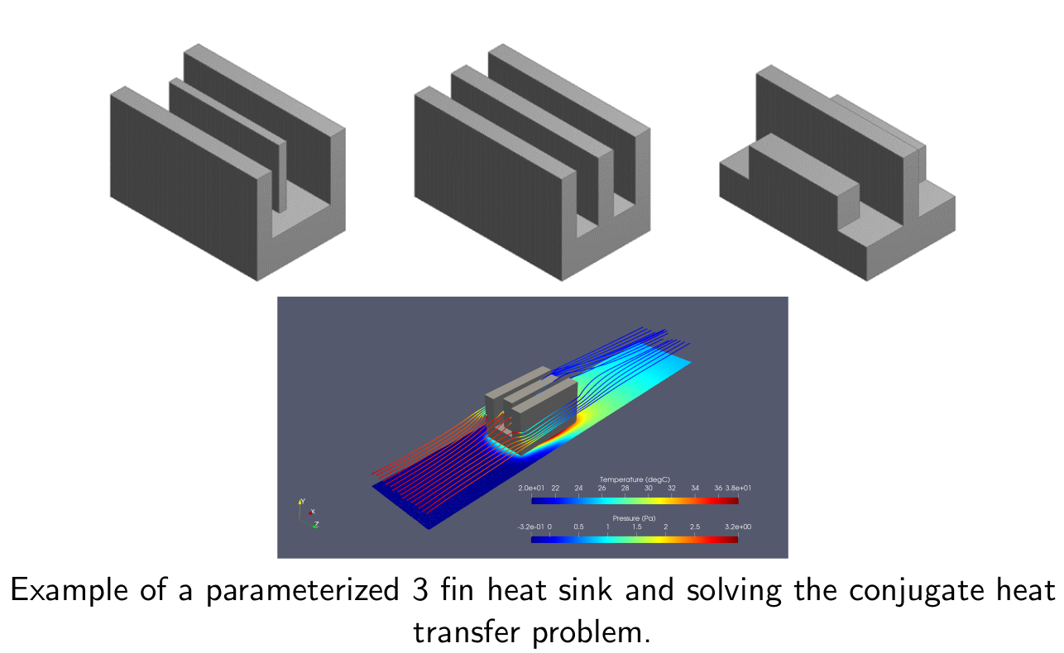
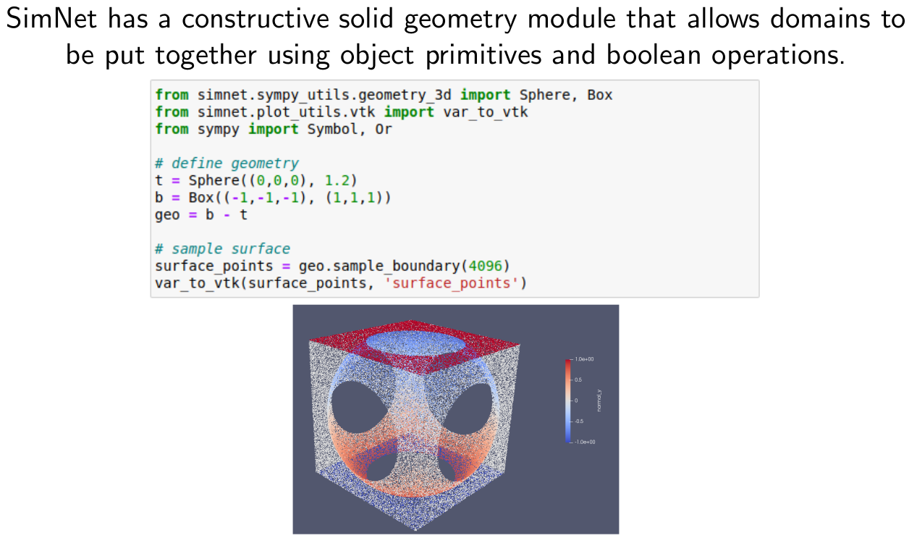
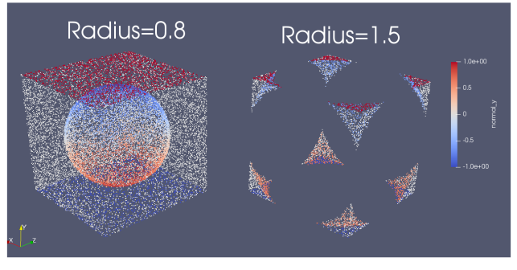
Modulus Features
Constructive Solid Geometry Module – Fully parameterizable with SymPy and allows Boolean ops
Allows to create complex geometries using a variety of primitives (​torus, cones, ellipse, etc.)
Supports functions like translate, rotate, scale, repeat, etc.
Example of a parameterized 3 Fin heatsink and solving the conjugate heat transfer problem.
Boolean (Union, Intersection and, Subtraction) of different primitives within Modulus
Geometry parameterizable using SymPy
Notes:
That completes our overview of data-driven models in Modulus. Now lets look at some of the Modulus features in detail.
Modulus provides a constructive solid geometry module that is fully parametereizable using Sympy and allows Boolean operations. It comes pre-built with several complex primitives like torus, cones, ellipse, etc. for user to choose from. These primitives also support operations like translate, rotate, scale and repeat. This , along with the ability to perform Boolean operations with these shapes allows us to create some fairly complicated shapes like shown here.

Slide 14
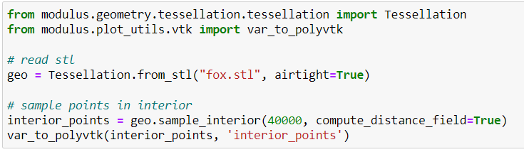
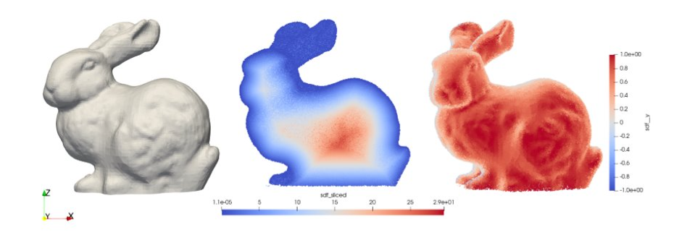
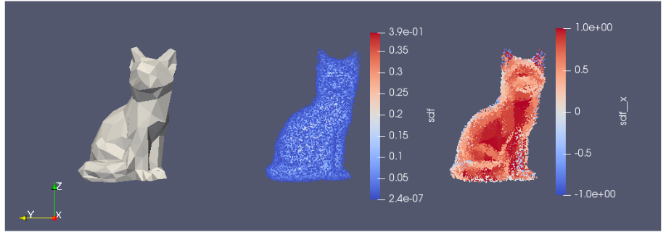
Modulus Features
PySDF library: Tessellated Geometry Module, OptiX for sampling and SDF
Allows to import complex tessellated geometries.​
Uses ray tracing to compute SDF and its derivatives. Also computes surface normals.​
Once the geometry is imported, creates a point cloud for training.​
Notes:
Another interesting module is the Modulus’s Tesselation module. It is an integration with NVIDIA’s PySDF library that uses OptiX for sampling and SDF computations. This allows us to import complex tessellated geometries. It uses ray-tracing to compute the SDF and its derivatives. The module also computes the surface normal. Once the geometry is imported, the point cloud can be used for training.

Slide 15
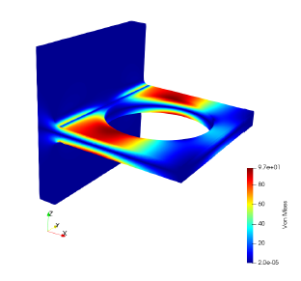
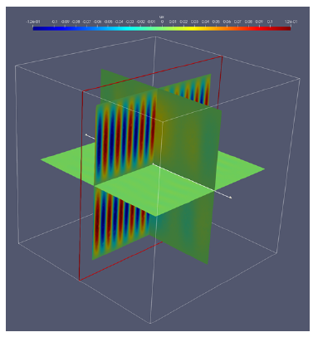
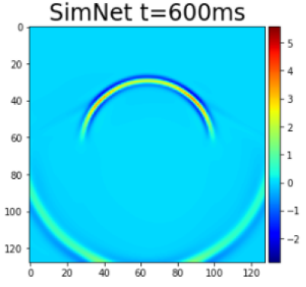
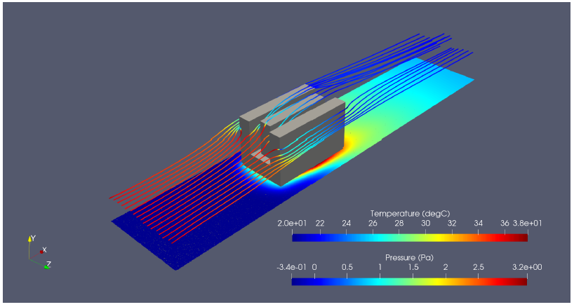
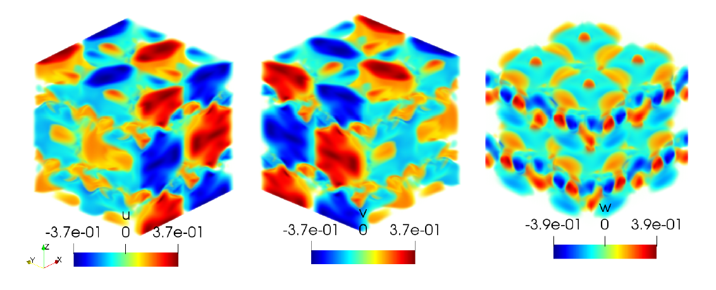
Modulus Features and Advancements
Physics types and solution of differential equations
Physics types:
Linear Elasticity (plane stress, plane strain and 3D)
Fluid Mechanics
Heat Transfer
Coupled Fluid-Thermal
Electromagnetics
Wave propagation
Examples of 2-eqn. turbulence (on fully developed channel case)
Solution of differential equations:
Ordinary Differential Equations
Differential (strong) Form
Integral (weak) form of the PDEs
Linear Elasticity
Electromagnetics
Modulus t=600ms
Conjugate Heat Transfer
Taylor-Green vortex decay
Wave Propagation

Slide 16
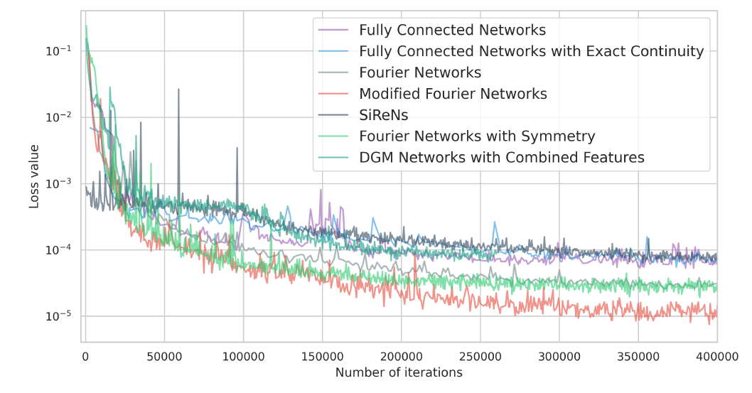
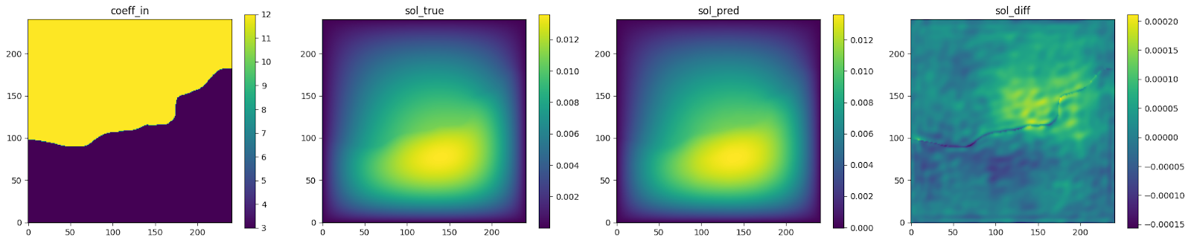
Modulus Features and Advancements
Network Architectures
Several neural network architectures:
Fully connected Network
Fourier Feature Network
Sinusoidal Representation Network (SiReN)
Modified Fourier Network
Deep Galerkin Method Network
Modified Highway Network
Multiplicative Filter Networks
Operators:
Fourier Neural Operator (FNO)
Adaptive Fourier Neural Operator (AFNO)
Physics Informed Fourier Neural Operator (PINO)
DeepONet
Comparisons of various networks in Modulus applied to solve the flow over a heatsink
Darcy Flow problem using FNO in Modulus

Slide 17
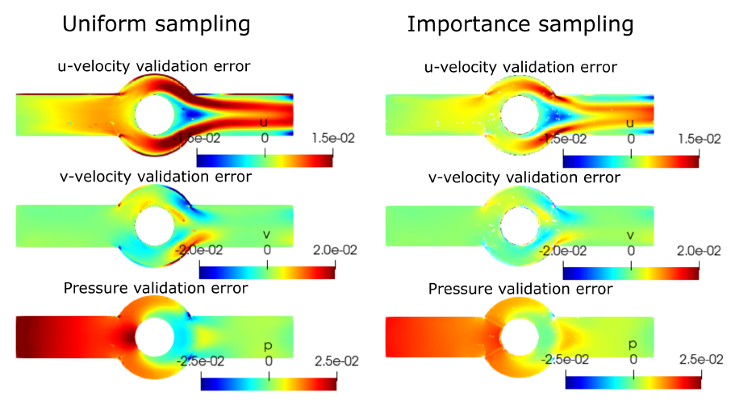
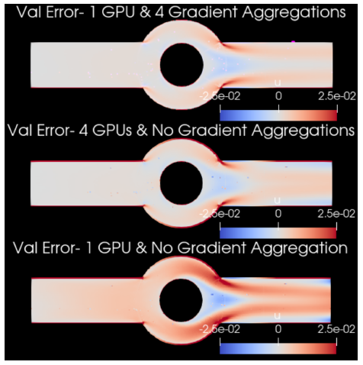
Modulus Features and Advancements
Other advanced training features
Other Features include:
Support for new optimizers
AdaHessian and up to 30+ optimizers (from PyTorch’s torch_optimizer library)
New algorithms for loss balancing
GradNorm, ReLoBRaLo, Soft Adapt, NTK, etc.
Sobolev (gradient-enhanced) training
Exact boundary condition imposition
Global and local learning rate annealing
Global adaptive activation functions
Halton sequences for low-discrepancy point cloud creation
Gradient Accumulation
Time-stepping schemes for transient problems
Temporal loss weighting and time marching for the continuous time approach
Importance sampling
Homoscedastic task uncertainty quantification for loss weighting
Hydra Configs for easy hyper-parameter tuning
Importance sampling
Handling larger batch sizes using Multi-GPU and/or Gradient Aggregation

Slide 18
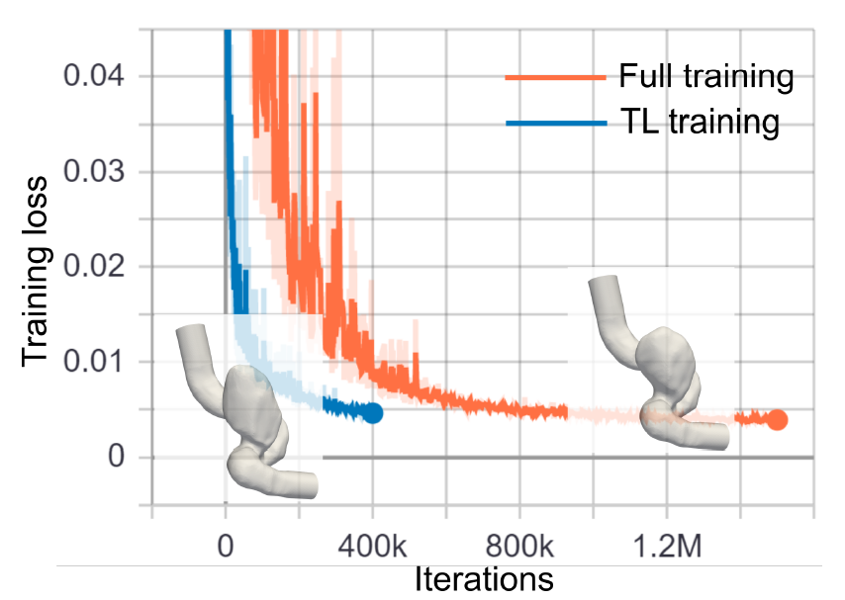
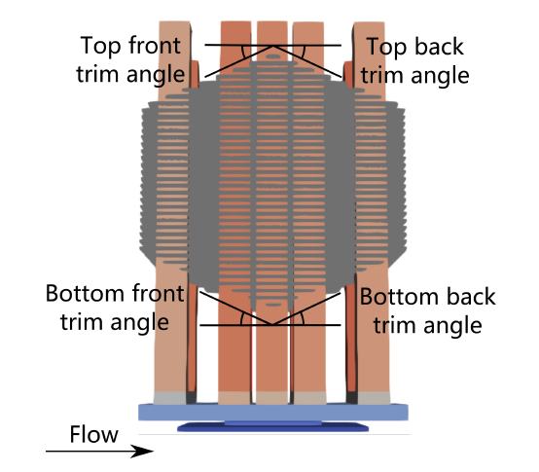
Modulus Features and Advancements
Other advanced training features
APIs to automatically generate point clouds from Boolean compositions of geometry primitives or import point cloud for complex geometry (e.g., STL files)
Parameterized system representation that solves several configurations concurrently for analytical geometry using Modulus CSG module
Transfer learning for efficient surrogate-based parameterization of STL and constructive solid geometries
STL geometry and Transfer Learning
Geometry parameterization using Modulus’ CSG module

Slide 19

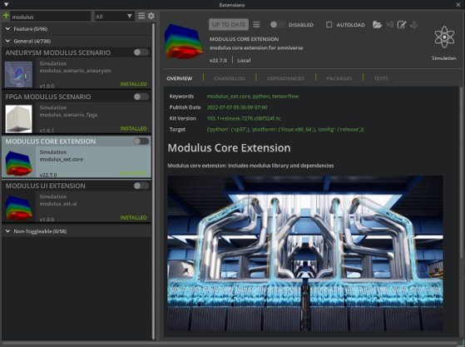
Omniverse Extension for Modulus
NVIDIA Omniverse™ is an easily extensible platform for 3D design collaboration and scalable multi-GPU, real-time, true-to-reality simulation. Omniverse revolutionizes the way we create and develop as individuals and work together as teams, bringing more creative possibilities and efficiency to 3D creators, developers and enterprises. ​​
Omniverse extension for Modulus enables real-time virtual-world simulation and full-design fidelity visualization. The built-in pipeline can be used for common visualizations such as streamlines and iso-surfaces for the outputs of the Modulus model. Another key feature is being able to visualize and analyze the high-fidelity simulation output in near real time as the design parameters are varied.​
For more information, please refer Modulus Extension Docs

Slide 20
Modulus Resources
Download Now: https://developer.nvidia.com/modulus-downloads​
Webpage: https://developer.nvidia.com/modulus​
Documentation: https://sw-docs-dgx-station.nvidia.com/deeplearning/modulus/index.html​
Developer Forum: https://forums.developer.nvidia.com/c/physics-simulation​
Demos:​
Accelerating Extreme Weather Prediction with FourCastNet​
Siemens Energy HRSG Digital Twin Simulation Using NVIDIA Modulus and Omniverse​
Accelerating Scientific & Engineering Simulation Workflows with AI​
Flow Physics Quantification in an Aneurysm Using NVIDIA Modulus​
Blogs: ​
AI and Machine Learning in Physics​
Using NVIDIA Modulus and Omniverse Wind Farm Digital Twin for Siemens Gamesa (using NVIDIA Modulus and Omniverse)​
Siemens Energy Taps NVIDIA to Develop Industrial Digital Twin of Power Plant in Omniverse and Modulus​
Using Hybrid Physics-Informed Neural Networks for Digital Twins in Prognosis and Health Management​
Using Physics-Informed Deep Learning for Transport in Porous Media​

Slide 21
Modulus Resources
Papers:​
NVIDIA SimNet™: An AI-Accelerated Multi-Physics Simulation Framework​
Physics-Informed Machine Learning and Uncertainty Quantification for Mechanics of Heterogeneous Materials​
Physics Informed RNN-DCT Networks for Time-Dependent Partial Differential Equations
​ Talks:​
A Novel Framework for Physics based Machine Learning in Science & Engineering Domains​
Accelerate HPC Simulations at Scale with Physics-informed Neural Networks and NVIDIA GPUs on AWS​
Toward Developing High Reynolds Number, Compressible, Reacting Flows in Modulus​
Physics-informed Neural Networks for Wave Propagation Using NVIDIA Modulus​
Uncertainty Quantification for Transport in Porous Media Using Parameterized Physics Informed Neural Networks​
Using Physics-Informed Neural Networks and Modulus to Accelerate Product Development​
Physics-Informed Neural Networks for Mechanics of Heterogenous Media​
Hybrid Physics-Informed Neural Networks for Digital Twin in Prognosis and Health Management​
Physics-Informed Neural Network for Flow and Transport in Porous Media​
AI-Accelerated Computational Science and Engineering Using Physics-Based Neural Networks​
Cumulative Damage Models, Hybrid-Physics-Informed Neural Networks, and Digital TwinsWWCumulative Damage Models, Hybrid-Physics-Informed Neural Networks, and Digital Twins​
NVIDIA Modulus - Accelerating Scientific & Engineering Simulation workflows with AI​
Podcast:​
AI Physics Simulation Toolkit SimNet & PINNs​

